Slide 1
Crop-Aware Panoptic Segmentation
Mehdi Naouar, Ben Bausch, Yannick Vogt

Slide 2
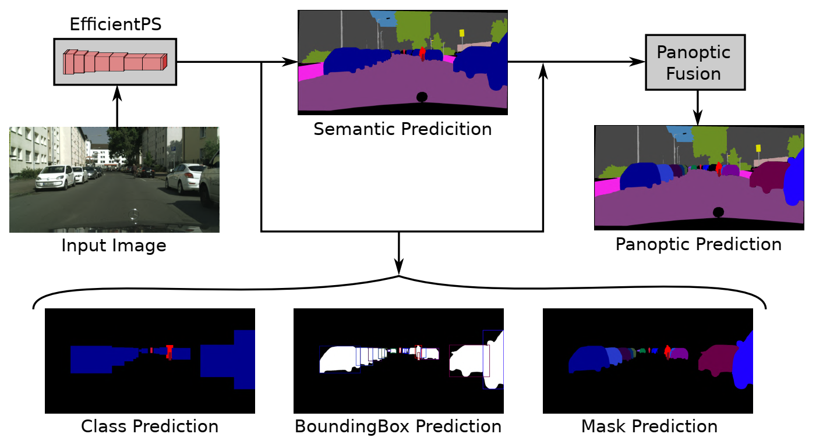
Panoptic Segmentation
Notes:
What is Panoptic Segmentation?
Whats the goal?
Rohits Paper

Slide 3
Bounding Box Prediction
Fully Connected Layer
Region Proposal Network proposes so called anchor boxes (expressed as center width height)
Bounding Box prediction regresses what change needs to be applied to the anchor in order to fit the ground truth Bounding Box
SmoothL1Loss on the four predicted box parameters
Notes:
Überleitung: What happens if we train on a crop of the image?

Slide 4
Crop Based Training
Add here what happens to the gt if we crop
Lower memory burden allowing training of larger networks or higher batch size
Training on crops with fine details can increase performance on small/far objects

Slide 5
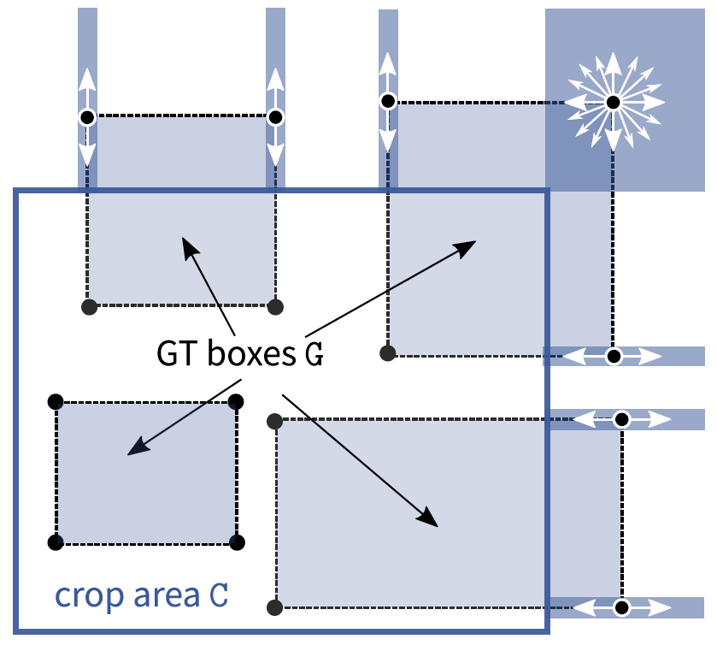
Crop-Aware Bounding Boxes
Network is allowed to “hallucinate”
Can improve performance on objects which were cropped in training
Notes:
Explain cases, maybe also show a O2 version
only outside can be modified

Slide 6
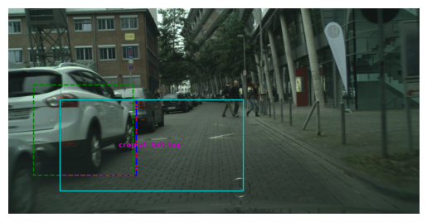
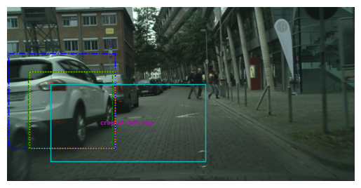
Visualization of Cabb
Without CABB
With CABB
Ground Truth, Prediction, Crop Area, Anchor Box, CABB Target
Notes:
TODO add loss values here
With CABB is an adapted version is a greater equal in SOLVE O1
Left ground truth is cropped
We save the original gt
Right side we optimize a new target that minimizes loss based on cases
Explain colors

Slide 7
Training Setting
1024*512 Image size, 512*256 Crop size
8 Image per Batch on a single GPU
100 epochs of training with 2975 training images

Slide 8
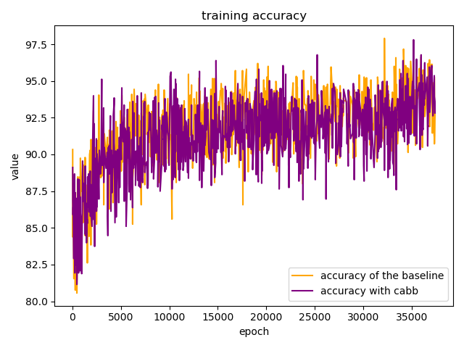
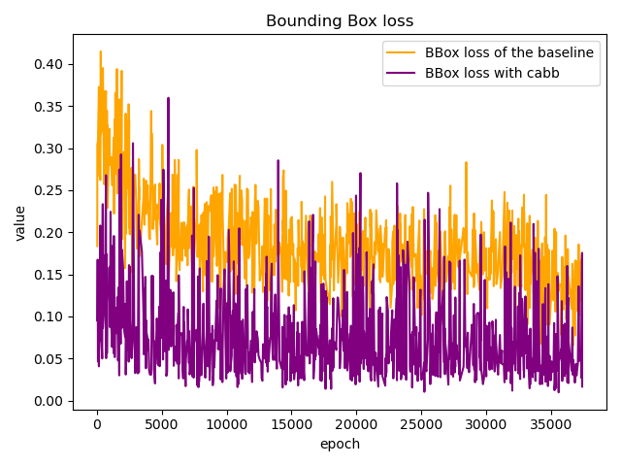
Training Results
39.5h for baseline vs 20.5h for the baseline
Notes:
Loss is lower (as we expected, perhaps we would need to weight this loss higher)
Loss has spikes, perhaps based on missing case
Test on 500 images

Slide 9
Test Results
Test on 500 images
Base | PQ | SQ | RQ | N
All | 47.6 | 75.5 | 60.9 | 19
Things | 42.0 | 75.1 | 55.8 | 8
Stuff | 51.7 | 75.8 | 64.5 | 11
CABB | PQ | SQ | RQ | N
All | 46.1 | 74.9 | 59.2 | 19
Things | 38.2 | 72.7 | 52.1 | 8
Stuff | 51.9 | 76.5 | 64.4 | 11

Slide 10
Thank you for your attention!

